Slide 1
WQD7010 Network & Security
Dr. Saaidal Razalli Bin Azzuhri
Dept. of Comp System & Technology
Fac. of Science Comp & IT.

Slide 2
WQD7010
My contact details:
- email: saaidal@um.edu.my
- Phone (O): 0379677022 ext 2507
- Phone (M): 0133306515
- Room: B-2-14

Slide 3
Assessment is through…
Final exam – 50%
Mid-Term – 20%
Group/Individual Assignment – 30%
Do the lab assignments during lab hours or outside – not graded, but exam or mid term can be from the lab assignments
For group assignment, identified free riders will get 0!!!!
Fraud (copying from your peers, others or internet, or allow your friend to copy from you, or sharing your solutions publicly) will not be tolerated, will get 0!!!
If caught, will be handed straight to examination/disciplinary committee!!!

Slide 4
L1: Introduction to Network Security (Outline)
Security Concept
OSI Security Architecture (Security Attacks, Mechanisms and Services)
Methods of Defense
A model for Internetwork Security
Internet standards and RFC

Slide 5
Background
Traditionally, before the widespread use of computers, security was provided by
– physical means – locked filing cabinets
– administrative mechanisms – rigid hiring process
In recent times, especially in global networking environment, the security requirements have changed
Another major change that affected security is the introduction of distributed systems and the use of networks and communications facilities for carrying data between terminal user and computer and between computer and computer
Ensuring security is a far more complicated issue today
Computer use requires automated tools to protect files and other stored information
Use of networks and communications links requires measures to protect data during transmission

Slide 6
Case Study
The Australian Institute of Criminology survey in 2016 revealed
(https://aic.gov.au/publications/tandi/tandi526)
The rapid growth of the internet is transforming how we engage and communicate. It also creates new opportunities for fraud and data theft.
In a sample of more than 13 million emails identified as spam, more than 100,000 contained malicious attachments; nearly 1.4 million contained malicious web links that allows cybercriminals to remotely access them.
The Australian economy relies on networked computer systems across all business sectors
About 91,927 small businesses reported a response to security breach in 2013 these organizations suffered financial loss
- $890m
- loss of productivity, customer confidence

Slide 7
News on Cyber Attack
Toyota Australia & Melbourne Hospital Under Cyber Attacks (https://tendaily.com.au/news/crime/a190220gad/cyber-ransom-attacks-on-the-rise-as-toyota-and-melbourne-hospital-become-latest-victims-20190221/)
A cyber crime syndicate accessed the medical files of 15,000 patients at Melbourne Heart Group at Melbourne's Cabrini Hospital.
The attack corrupted data in the system and completely crippled its servers.
It is believed the records were hacked by malware originating from either North Korea or Russia, but this is yet to be confirmed.
Meanwhile, Toyota Australia has confirmed it has been subject to an attempted cyber attack.
These hacks come just days after Prime Minister Scott Morrison revealed Australia's major political parties were hacked by a foreign government.
The company has confirmed the attempted attack that took out its e-mail system, forcing employees to turn to other forms of communication to continue working

Slide 8
News On Cyber Attack
Media Prima hit by ransomware, hackers demand RM26mil in bitcoins (https://www.thestar.com.my/news/nation/2018/11/13/media-prima-hit-by-ransomware-hackers-demand-rm26mil-in-bitcoins-says-report/)
Media Prima Berhad's computer systems have been locked out by cyber attackers who are demanding millions of ringgit in ransom.
The media company, which runs a stable of TV/radio channels, newspapers, advertising and digital media companies was hit by a ransomware attack last Thursday (Nov 8), The Edge Financial Daily reported.
The report, quoting a source, said the attackers are demanding 1,000 bitcoins to release access to the computer systems.
The source reportedly added that Media Prima has decided not to pay the ransom.

Slide 9
Other Security News
My short interview with TV3, regarding 5G security (24 Jan 2019)
https://www.youtube.com/watch?v=bDbQNrCkiN4&feature=youtu.be

Slide 10
Computer Security
“The protection afforded to an automated information system in order to attain the applicable objectives of preserving the integrity, availability, and confidentiality of information system resources (includes hardware, software, firmware, information/data, and telecommunications)”
The NIST Computer Security Handbook defines the term computer security as:
Notes:
The NIST Computer Security Handbook [NIST95] defines the term computer security
as follows:
Computer Security: The protection afforded to an automated information system
in order to attain the applicable objectives of preserving the integrity, availability,
and confidentiality of information system resources (includes hardware, software,
firmware, information/data, and telecommunications).

Slide 11
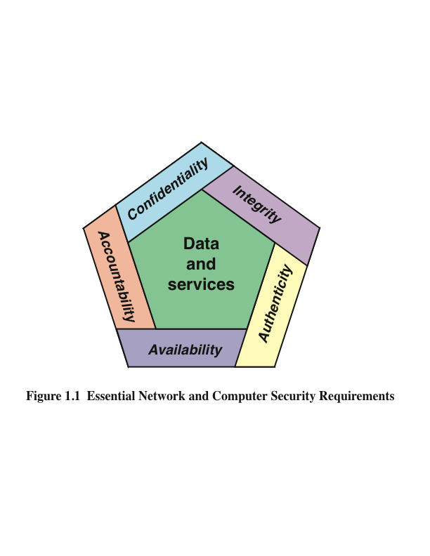
CIA Triad
Notes:
These three concepts form what is often referred to as the CIA triad . The
three concepts embody the fundamental security objectives for both data and for
information and computing services. For example, the NIST Standards for Security
Categorization of Federal Information and Information Systems (FIPS 199) lists
confidentiality, integrity, and availability as the three security objectives for information
and for information systems. FIPS 199 provides a useful characterization
of these three objectives in terms of requirements and the definition of a loss of
security in each category.
• Confidentiality: Preserving authorized restrictions on information access
and disclosure, including means for protecting personal privacy and proprietary
information. A loss of confidentiality is the unauthorized disclosure of
information.
• Integrity: Guarding against improper information modification or destruction,
including ensuring information nonrepudiation and authenticity. A loss of
integrity is the unauthorized modification or destruction of information.
• Availability: Ensuring timely and reliable access to and use of information.
A loss of availability is the disruption of access to or use of information or an
information system.

Slide 12
Computer Security Objectives
Confidentiality
Data confidentiality
Assures that private or confidential information is not made available or disclosed to unauthorized individuals
Privacy
Assures that individuals control or influence what information related to them may be collected and stored and by whom and to whom that information may be disclosed
Integrity
Availability
Assures that systems work promptly and service is not denied to authorized users
Assures that a system performs its intended function in an unimpaired manner, free from deliberate or inadvertent unauthorized manipulation of the system
System integrity
Assures that information and programs are changed only in a specified and authorized manner
Data integrity
Notes:
This definition introduces three key objectives that are at the heart of computer
security:
• Confidentiality: This term covers two related concepts:
Data confidentiality: Assures that private or confidential information is
not made available or disclosed to unauthorized individuals.
Privacy: Assures that individuals control or influence what information
related to them may be collected and stored and by whom and to whom
that information may be disclosed.
•Integrity: This term covers two related concepts:
Data integrity: Assures that information and programs are changed only in
a specified and authorized manner.
System integrity: Assures that a system performs its intended function in
an unimpaired manner, free from deliberate or inadvertent unauthorized
manipulation of the system.
• Availability: Assures that systems work promptly and service is not denied to
authorized users.

Slide 13
Possible additional concepts:
Authenticity
Verifying that users are who they say they are and that each input arriving at the system came from a trusted source
Accountability
The security goal that generates the requirement for actions of an entity to be traced uniquely to that entity
Notes:
Although the use of the CIA triad to define security objectives is well established,
some in the security field feel that additional concepts are needed to present
a complete picture. Two of the most commonly mentioned are as follows:
• Authenticity: The property of being genuine and being able to be verified and
trusted; confidence in the validity of a transmission, a message, or message
originator. This means verifying that users are who they say they are and that
each input arriving at the system came from a trusted source.
• Accountability: The security goal that generates the requirement for actions
of an entity to be traced uniquely to that entity. This supports nonrepudiation,
deterrence, fault isolation, intrusion detection and prevention, and after action
recovery and legal action. Because truly secure systems are not yet an
achievable goal, we must be able to trace a security breach to a responsible
party. Systems must keep records of their activities to permit later forensic
analysis to trace security breaches or to aid in transaction disputes.

Slide 14
Definitions
Computer Security or Information Security
generic name for the collection of tools designed to protect data and to thwart hackers
Network Security
measures to protect data during their transmission (crucial in distributed system, networks and communication facilities)
Internet Security
measures to protect data during their transmission over a collection of interconnected networks (Internetwork security)

Slide 15
Security Focus
Consists of measures to prevent, detect, and correct security violations that involve the storage and transmission of information
Few Examples:
A transmits a sensitive file to B that must be protected from disclosure. C, not authorized to read the file, monitors the transmission and captures the file during transmission
D intercepts a message during transmission, changes the content and transmits to F as if it originated from E.
A message is sent from a customer to a stockbroker with instructions of transactions. Subsequently, the investments lose value and the customer denies sending the message

Slide 16
Breach of Security: Levels of Impact
High
The loss could be expected to have a severe or catastrophic adverse effect on organizational operations, organizational assets, or individuals
Moderate
The loss could be expected to have a serious adverse effect on organizational operations, organizational assets, or individuals
Low
The loss could be expected to have a limited adverse effect on organizational operations, organizational assets, or individuals
Notes:
We use three levels of impact on organizations or
individuals should there be a breach of security (i.e., a loss of confidentiality, integrity,
or availability). These levels are defined in FIPS PUB 199:
• Low: The loss could be expected to have a limited adverse effect on organizational
operations, organizational assets, or individuals. A limited adverse
effect means that, for example, the loss of confidentiality, integrity, or availability
might (i) cause a degradation in mission capability to an extent and
duration that the organization is able to perform its primary functions, but the
effectiveness of the functions is noticeably reduced; (ii) result in minor damage
to organizational assets; (iii) result in minor financial loss; or (iv) result in
minor harm to individuals.
• Moderate: The loss could be expected to have a serious adverse effect on
organizational operations, organizational assets, or individuals. A serious
adverse effect means that, for example, the loss might (i) cause a significant
degradation in mission capability to an extent and duration that the
organization is able to perform its primary functions, but the effectiveness
of the functions is significantly reduced; (ii) result in significant damage to
organizational assets; (iii) result in significant financial loss; or (iv) result in
significant harm to individuals that does not involve loss of life or serious,
life-threatening injuries.
• High: The loss could be expected to have a severe or catastrophic adverse
effect on organizational operations, organizational assets, or individuals.
A severe or catastrophic adverse effect means that, for example, the loss might
(i) cause a severe degradation in or loss of mission capability to an extent and
duration that the organization is not able to perform one or more of its primary
functions; (ii) result in major damage to organizational assets; (iii) result
in major financial loss; or (iv) result in severe or catastrophic harm to individuals
involving loss of life or serious, life-threatening injuries.

Slide 17
Examples of Security Requirements
Confidentiality
Student grade information is an asset whose confidentiality is considered to be highly important by students
Regulated by the Family Educational Rights and Privacy Act (FERPA)
Integrity
Patient information stored in a database – inaccurate information could result in serious harm or death to a patient and expose the hospital to massive liability
A Web site that offers a forum to registered users to discuss some specific topic would be assigned a moderate level of integrity
An example of a low-integrity requirement is an anonymous online poll
Availability
The more critical a component or service, the higher the level of availability required
A moderate availability requirement is a public Web site for a university
An online telephone directory lookup application would be classified as a low-availability requirement
Notes:
Confidentiality
Student grade information is an asset whose confidentiality is
considered to be highly important by students. In the United States, the release of
such information is regulated by the Family Educational Rights and Privacy Act
(FERPA). Grade information should only be available to students, their parents,
and employees that require the information to do their job. Student enrollment
information may have a moderate confidentiality rating. While still covered by
FERPA, this information is seen by more people on a daily basis, is less likely to be
targeted than grade information, and results in less damage if disclosed. Directory
information (such as lists of students, faculty, or departmental lists) may be assigned
a low confidentiality rating or indeed no rating. This information is typically freely
available to the public and published on a school’s Web site.
Integrity
Several aspects of integrity are illustrated by the example of a hospital
patient’s allergy information stored in a database. The doctor should be able to
trust that the information is correct and current. Now suppose that an employee
(e.g., a nurse) who is authorized to view and update this information deliberately
falsifies the data to cause harm to the hospital. The database needs to be restored
to a trusted basis quickly, and it should be possible to trace the error back to the
person responsible. Patient allergy information is an example of an asset with a high
requirement for integrity. Inaccurate information could result in serious harm or
death to a patient and expose the hospital to massive liability.
An example of an asset that may be assigned a moderate level of integrity
requirement is a Web site that offers a forum to registered users to discuss some
specific topic. Either a registered user or a hacker could falsify some entries or deface
the Web site. If the forum exists only for the enjoyment of the users, brings
in little or no advertising revenue, and is not used for something important such
as research, then potential damage is not severe. The Web master may experience
some data, financial, and time loss.
An example of a low-integrity requirement is an anonymous online poll. Many
Web sites, such as news organizations, offer these polls to their users with very few
safeguards. However, the inaccuracy and unscientific nature of such polls are well
understood.
Availability
The more critical a component or service, the higher is the level of
availability required. Consider a system that provides authentication services for
critical systems, applications, and devices. An interruption of service results in the
inability for customers to access computing resources and for the staff to access
the resources they need to perform critical tasks. The loss of the service translates
into a large financial loss due to lost employee productivity and potential
customer loss.
An example of an asset that typically would be rated as having a moderate
availability requirement is a public Web site for a university; the Web site provides
information for current and prospective students and donors. Such a site is not a
critical component of the university’s information system, but its unavailability will
cause some embarrassment.
An online telephone directory lookup application would be classified as a low availability
requirement. Although the temporary loss of the application may be
an annoyance, there are other ways to access the information, such as a hardcopy
directory or the operator.

Slide 18

Computer Security Challenges
Security is not simple
Potential attacks on the security features need to be considered
Procedures used to provide particular services are often counter-intuitive
It is necessary to decide where to use the various security mechanisms
Requires constant monitoring
Is too often an afterthought
Security mechanisms typically involve more than a particular algorithm or protocol
Security is essentially a battle of wits between a perpetrator and the designer
Little benefit from security investment is perceived until a security failure occurs
Strong security is often viewed as an impediment to efficient and user-friendly operation
Notes:
Computer and network security is both fascinating and complex. Some of the reasons
include:
1. Security is not as simple as it might first appear to the novice. The requirements
seem to be straightforward; indeed, most of the major requirements for
security services can be given self-explanatory, one-word labels: confidentiality,
authentication, nonrepudiation, and integrity. But the mechanisms used to
meet those requirements can be quite complex, and understanding them may
involve rather subtle reasoning.
2. In developing a particular security mechanism or algorithm, one must always
consider potential attacks on those security features. In many cases, successful
attacks are designed by looking at the problem in a completely different way,
therefore exploiting an unexpected weakness in the mechanism.
3. Because of point 2, the procedures used to provide particular services are
often counterintuitive. Typically, a security mechanism is complex, and it is not
obvious from the statement of a particular requirement that such elaborate
measures are needed. It is only when the various aspects of the threat are considered
that elaborate security mechanisms make sense.
4. Having designed various security mechanisms, it is necessary to decide where
to use them. This is true both in terms of physical placement (e.g., at what points
in a network are certain security mechanisms needed) and in a logical sense
[e.g., at what layer or layers of an architecture such as TCP/IP (Transmission
Control Protocol/Internet Protocol) should mechanisms be placed].
5. Security mechanisms typically involve more than a particular algorithm or
protocol. They also require that participants be in possession of some secret information
(e.g., an encryption key), which raises questions about the creation,
distribution, and protection of that secret information. There also may be a reliance
on communications protocols whose behavior may complicate the task
of developing the security mechanism. For example, if the proper functioning
of the security mechanism requires setting time limits on the transit time of a
message from sender to receiver, then any protocol or network that introduces
variable, unpredictable delays may render such time limits meaningless.
6. Computer and network security is essentially a battle of wits between a perpetrator
who tries to find holes and the designer or administrator who tries to
close them. The great advantage that the attacker has is that he or she need
only find a single weakness, while the designer must find and eliminate all
weaknesses to achieve perfect security.
7. There is a natural tendency on the part of users and system managers to
perceive little benefit from security investment until a security failure occurs.
8. Security requires regular, even constant, monitoring, and this is difficult in
today’s short-term, overloaded environment.
9. Security is still too often an afterthought to be incorporated into a system after
the design is complete rather than being an integral part of the design process.
10. Many users (and even security administrators) view strong security as an
impediment to efficient and user-friendly operation of an information
system or use of information.
The difficulties just enumerated will be encountered in numerous ways as we
examine the various security threats and mechanisms throughout this book.

Slide 19
OSI Layer

Slide 20
OSI Security Architecture
ITU-T X.800 “Security Architecture for OSI” defines a systematic way of defining and providing security requirements
Provides a useful, if abstract, overview of concepts that we will study
A systematic approach is necessary to address the task(s)
OSI security architecture provides a useful framework that defines such a systematic way
− To define the security requirements and
− Adopt approaches to satisfy those requirements

Slide 21
OSI Security Architecture
Focusing on three aspects of information security
Security Attacks
Security Mechanism
Security Services

Slide 22
Security Attacks
Any action that compromises the security of information owned by an organization
Vulnerability: a weakness in a computer system that might be exploited to cause loss or harm
Threat: circumstances that have the potential to cause loss or harm
Control: a protective measure
Information security is about how to prevent attacks, or failing that, to detect attacks on information-based systems
often threat & attack are used to mean the same thing
Have a wide range of attacks
Can focus on generic types of attacks

Slide 23
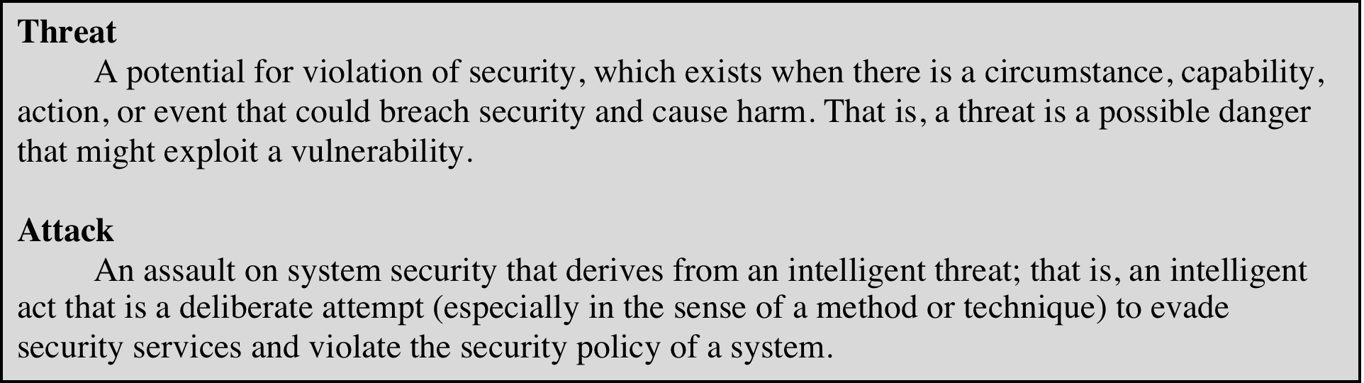
Threats and Attacks (RFC 4949)
Notes:
In the literature, the terms threat and attack are commonly used to mean more
or less the same thing. Table 1.1 provides definitions taken from RFC 4949, Internet
Security Glossary.

Slide 24
Security Attacks - Taxonomy
A security attack may attempt to do one or more of the following:
– Interruption: an attack on availability
– Interception: an attack on confidentiality
– Modification: an attack on integrity
– Fabrication: an attack on authenticity
Two types of security attacks:
– Passive Attacks
– Active Attacks

Slide 25
Interruption
Also known as denial of services (DoS).
Information resources (hardware, software and data) are deliberately made unavailable, lost or unusable, usually through malicious destruction.
e.g.: cutting a communication line, disabling a file management system, etc.

Slide 26
Interception
Also known as un-authorized access.
Difficult to trace as no traces of intrusion might be left.
e.g: illegal eavesdropping or wiretapping or sniffing, illegal copying.

Slide 27
Modification
Also known as tampering a resource.
Resources can be data, programs, hardware devices, etc.

Slide 28
Fabrication
Also known as counterfeiting (of objects such as data, programs, devices, etc).
Allows to by-pass the authenticity checks.
e.g.: insertion of spurious messages in a network, adding a record to a file, counterfeit bank notes, fake cheques,2
impersonation/masquerading
– to gain access to data, services etc..

Slide 29
Security Attacks - Taxonomy

Slide 30
Passive Attacks
Nature: eavesdropping on, or monitoring of, transmission of information between the communicating parties
Goal: to capture information during transmission
Two types of Passive attack:
– Release of message content
capture and read the content
- Traffic analysis
can’t read the information, but observe the pattern
determine the location and identity of communicating parties
observe frequency and length of communication

Slide 31
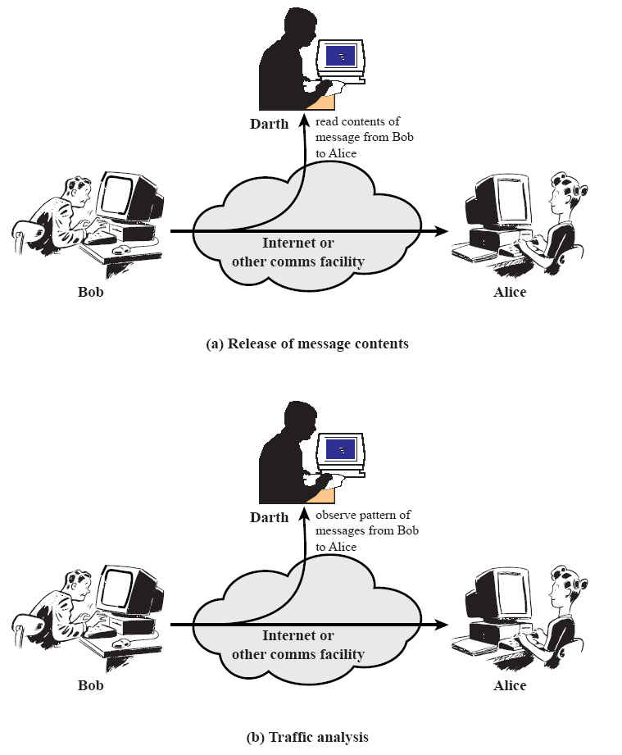
Passive Attacks

Slide 32
Active Attacks
Modifies a data stream or creates a false data streams
• Four types of active attacks:
– Masquerade: one entity pretends to be a different entity
> authentication sequences are captured and replayed
> an entity can gain extra privileges
– Replay: passive capture of data and subsequent retransmission
– Modification of Message: messages can be altered, delayed or reordered to produce unauthorized effect
– Denial of Service: prevents normal use or management of communication facilities
> usually have a specific target
> disruption of services of an entire network or suppression of all
messages directed to a particular destination

Slide 33
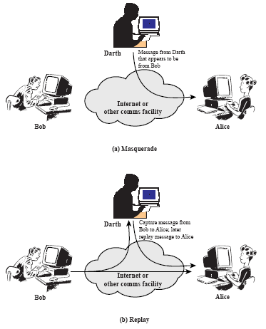
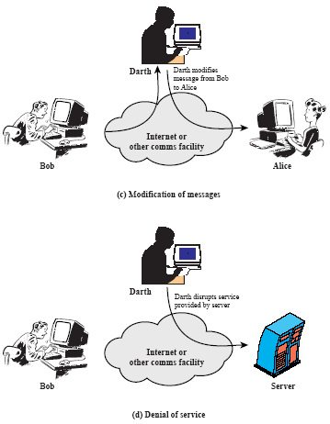
Active Attacks

Slide 34
Security Attacks in Nutshells

Slide 35
Security Services
Enhance the security of the data processing systems and the information transfers of an organization
Intended to counter security attacks
Make use of one or more security mechanisms to provide the service
Replicate functions normally associated with physical documents
– e.g have signatures, dates;
– need protection from disclosure, tampering, or destruction;
– be notarized or witnessed;
– be recorded or licensed

Slide 36
Security Services
Defined by X.800 as:
A service provided by a protocol layer of communicating open systems and that ensures adequate security of the systems or of data transfers
Defined by RFC 4949 as:
A processing or communication service provided by a system to give a specific kind of protection to system resources

Slide 37
X.800 Service Categories
X.800 defines security services into 5 major categories:
– Data Confidentiality
– Data Integrity
– Authentication
– Non-repudiation
– Access control

Slide 38
X.800 Service Categories
Data Confidentiality – protection of data from unauthorized disclosure
Data Integrity - assurance that data received has not been modified by an unauthorized entity
Authentication: assures that the communication is authentic
– communicating entities are who they claim to be
– have both peer-entity &data origin authentication
Access Control - prevention of the unauthorized use of a resource
Non-Repudiation - protection against denial by one of the parties in a communication
– Receiver can prove that sender has sent the message
– Sender can proof the receiver has received the message

Slide 39
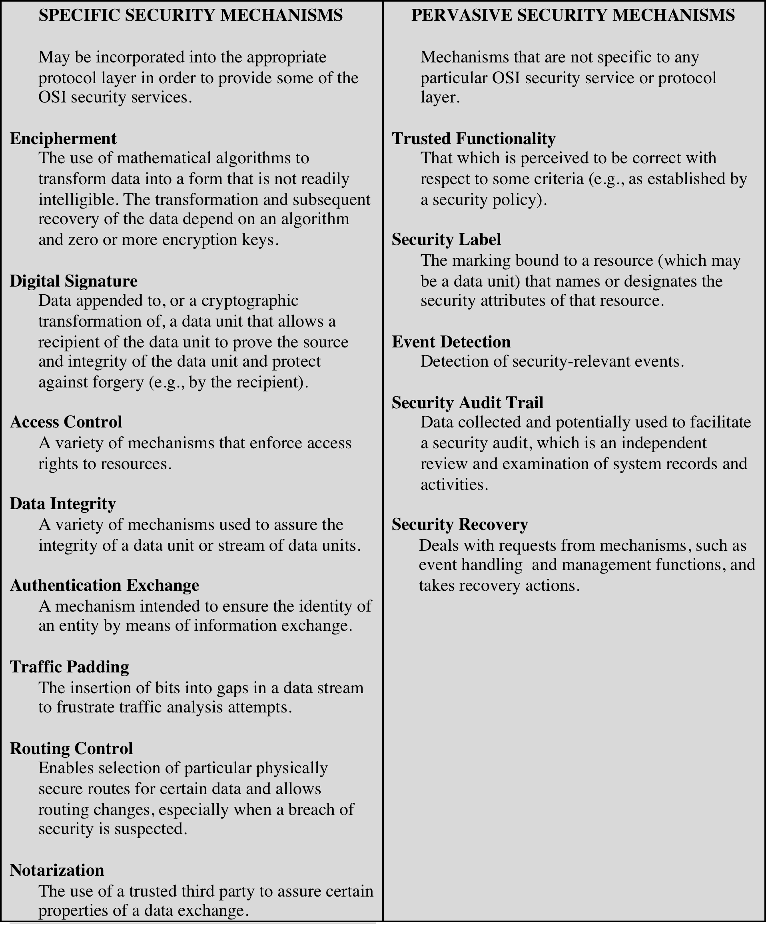
X.800 Security Mechanism
specific security mechanisms are protocol layer specific, whilst the
pervasive security mechanisms are not!!

Slide 40
X.800 Security Mechanism
Security services are implemented by one or more security mechanism
Security mechanisms are invoked at appropriate layers and in appropriate combinations
See the Table 1.4 for relationship between different security service and mechanism

Slide 42
Fundamental security design principles
The National Centers of Academic Excellence in Information Assurance/Cyber Defense, which is jointly sponsored by the U.S. Department of Homeland Security, list the following as fundamental security design principles:
Economy of mechanism
Fail-safe defaults
Complete mediation
Open design separation of privilege
Least privilege
Least common mechanism
Psychological acceptability
Isolation
Encapsulation
Modularity
Layering
Least astonishment
Notes:
Despite years of research and development, it has not been possible to develop
security design and implementation techniques that systematically exclude security
flaws and prevent all unauthorized actions. In the absence of such foolproof techniques,
it is useful to have a set of widely agreed design principles that can guide
the development of protection mechanisms. The National Centers of Academic
Excellence in Information Assurance/Cyber Defense, which is jointly sponsored by
the U.S. National Security Agency and the U.S. Department of Homeland Security,
list the following as fundamental security design principles [NCAE13]:
■ Economy of mechanism
■ Fail-safe defaults
■ Complete mediation
■ Open design
■ Separation of privilege
■ Least privilege
■ Least common mechanism
■ Psychological acceptability
■ Isolation
■ Encapsulation
■ Modularity
■ Layering
■ Least astonishment
The first eight listed principles were initially proposed in [SALT75] and have
withstood the test of time.

Slide 43
Fundamental security design principles
Economy of mechanism
The design of security measures embodied in both hardware and software should be as simple and small as possible
Fail-safe default
Access decisions should be based on permission rather than exclusion—the default situation is lack of access, and the protection scheme identifies conditions under which access is permitted
Complete mediation
Every access must be checked against the access control mechanism
Open design
The design of a security mechanism should be open rather than secret
Separation of privilege
A practice in which multiple privilege attributes are required to achieve access to a restricted resource
Least privilege
Every process and every user of the system should operated using the least set of privileges necessary to perform the task
Least common mechanism
The design should minimize the functions shared by different users, providing mutual security
Psychological acceptability
Implies that the security mechanisms should not interfere unduly with the work of users, while at the same time meeting the needs of those who authorize access
Notes:
Economy of mechanism means that the design of security measures embodied
in both hardware and software should be as simple and small as possible. The
motivation for this principle is that relatively simple, small design is easier to test
and verify thoroughly. With a complex design, there are many more opportunities
for an adversary to discover subtle weaknesses to exploit that may be difficult
to spot ahead of time. The more complex the mechanism, the more likely it is to
possess exploitable flaws. Simple mechanisms tend to have fewer exploitable flaws
and require less maintenance. Further, because configuration management issues
are simplified, updating or replacing a simple mechanism becomes a less intensive
process. In practice, this is perhaps the most difficult principle to honor. There is a
constant demand for new features in both hardware and software, complicating the
security design task. The best that can be done is to keep this principle in mind during
system design to try to eliminate unnecessary complexity.
Fail-safe default means that access decisions should be based on permission
rather than exclusion. That is, the default situation is lack of access, and the protection
scheme identifies conditions under which access is permitted. This approach
exhibits a better failure mode than the alternative approach, where the default is
to permit access. A design or implementation mistake in a mechanism that gives
explicit permission tends to fail by refusing permission, a safe situation that can
be quickly detected. On the other hand, a design or implementation mistake in a
mechanism that explicitly excludes access tends to fail by allowing access, a failure
that may long go unnoticed in normal use. For example, most file access systems
work on this principle and virtually all protected services on client/server systems
work this way.
Complete mediation means that every access must be checked against the
access control mechanism. Systems should not rely on access decisions retrieved
from a cache. In a system designed to operate continuously, this principle requires
that, if access decisions are remembered for future use, careful consideration should
be given to how changes in authority are propagated into such local memories. File
access systems appear to provide an example of a system that complies with this
principle. However, typically, once a user has opened a file, no check is made to see
if permissions change. To fully implement complete mediation, every time a user
reads a field or record in a file, or a data item in a database, the system must exercise
access control. This resource-intensive approach is rarely used.
Open design means that the design of a security mechanism should be open
rather than secret. For example, although encryption keys must be secret, encryption
algorithms should be open to public scrutiny. The algorithms can then be
reviewed by many experts, and users can therefore have high confidence in them.
This is the philosophy behind the National Institute of Standards and Technology
(NIST) program of standardizing encryption and hash algorithms and has led to the
widespread adoption of NIST-approved algorithms.
Separation of privilege is defined in [SALT75] as a practice in which multiple
privilege attributes are required to achieve access to a restricted resource. A good
example of this is multifactor user authentication, which requires the use of multiple
techniques, such as a password and a smart card, to authorize a user. The term is
also now applied to any technique in which a program is divided into parts that are
limited to the specific privileges they require in order to perform a specific task. This
is used to mitigate the potential damage of a computer security attack. One example
of this latter interpretation of the principle is removing high privilege operations
to another process and running that process with the higher privileges required to
perform its tasks. Day-to-day interfaces are executed in a lower privileged process.
Least privilege means that every process and every user of the system should
operate using the least set of privileges necessary to perform the task. A good example
of the use of this principle is role-based access control, described in Chapter 4.
The system security policy can identify and define the various roles of users or processes.
Each role is assigned only those permissions needed to perform its functions.
Each permission specifies a permitted access to a particular resource (such as read
and write access to a specified file or directory, connect access to a given host and
port, etc.). Unless a permission is granted explicitly, the user or process should not
be able to access the protected resource. More generally, any access control system
should allow each user only the privileges that are authorized for that user. There
is also a temporal aspect to the least privilege principle. For example, system programs
or administrators who have special privileges should have those privileges
only when necessary; when they are doing ordinary activities, the privileges should
be withdrawn. Leaving them in place just opens the door to accidents.
Least common mechanism means that the design should minimize the functions
shared by different users, providing mutual security. This principle helps
reduce the number of unintended communication paths and reduces the amount of
hardware and software on which all users depend, thus making it easier to verify if
there are any undesirable security implications.
Psychological acceptability implies that the security mechanisms should not
interfere unduly with the work of users, while at the same time meeting the needs of
those who authorize access. If security mechanisms hinder the usability or accessibility
of resources, then users may opt to turn off those mechanisms. Where possible,
security mechanisms should be transparent to the users of the system or at most
introduce minimal obstruction. In addition to not being intrusive or burdensome,
security procedures must reflect the user’s mental model of protection. If the protection
procedures do not make sense to the user or if the user must translate his image
of protection into a substantially different protocol, the user is likely to make errors.

Slide 44
Fundamental security design principles
Isolation
A principle that applies in three contexts: first, public access systems should be isolated from critical resources to prevent disclosure to tampering; second, the processes and files of individual users should be isolated from one another except where it is explicitly desired; third, security mechanisms should be isolated in the sense of preventing access to those mechanisms
Encapsulation
Viewed as a specific form of isolation based on object-oriented functionality
Modularity
Refers both to the development of security functions as separate, protected modules and to the use of a modular architecture for mechanism design and implementation
Layering
Refers to the use of multiple, overlapping protection approaches addressing the people, technology, and operational aspects of information systems
Least privilege
Every process and every user of the system should operated using the least set of privileges necessary to perform the task
Least astonishment
A program or user interface should always respond in the way that is least likely to astonish the user
Notes:
Isolation is a principle that applies in three contexts. First, public access
systems should be isolated from critical resources (data, processes, etc.) to prevent
disclosure or tampering. In cases where the sensitivity or criticality of the
information is high, organizations may want to limit the number of systems on
which that data is stored and isolate them, either physically or logically. Physical
isolation may include ensuring that no physical connection exists between an
organization’s public access information resources and an organization’s critical
information. When implementing logical isolation solutions, layers of security
services and mechanisms should be established between public systems and
secure systems responsible for protecting critical resources. Second, the processes
and files of individual users should be isolated from one another except where
it is explicitly desired. All modern operating systems provide facilities for such
isolation, so that individual users have separate, isolated process space, memory
space, and file space, with protections for preventing unauthorized access.
Finally, security mechanisms should be isolated in the sense of preventing access
to those mechanisms. For example, logical access control may provide a means
of isolating cryptographic software from other parts of the host system, and for
protecting cryptographic software from tampering and the keys from replacement
or disclosure.
Encapsulation can be viewed as a specific form of isolation based on object-oriented
functionality. Protection is provided by encapsulating a collection of procedures
and data objects in a domain of its own so that the internal structure of a
data object is accessible only to the procedures of the protected subsystem, and the
procedures may be called only at designated domain entry points.
Modularity in the context of security refers both to the development of security
functions as separate, protected modules and to the use of a modular architecture
for mechanism design and implementation. With respect to the use of separate
security modules, the design goal here is to provide common security functions and
services, such as cryptographic functions, as common modules. For example, numerous
protocols and applications make use of cryptographic functions. Rather than
implementing such functions in each protocol or application, a more secure design
is provided by developing a common cryptographic module that can be invoked by
numerous protocols and applications. The design and implementation effort can
then focus on the secure design and implementation of a single cryptographic module
and including mechanisms to protect the module from tampering. With respect
to the use of a modular architecture, each security mechanism should be able to
support migration to new technology or upgrade of new features without requiring
an entire system redesign. The security design should be modular so that individual
parts of the security design can be upgraded without the requirement to modify the
entire system.
Layering refers to the use of multiple, overlapping protection approaches
addressing the people, technology, and operational aspects of information systems.
By using multiple, overlapping protection approaches, the failure or circumvention
of any individual protection approach will not leave the system unprotected.
We will see throughout this text that a layering approach is often used to provide
multiple barriers between an adversary and protected information or services. This
technique is often referred to as defense in depth.
Least astonishment means that a program or user interface should always
respond in the way that is least likely to astonish the user. For example, the mechanism
for authorization should be transparent enough to a user that the user has a
good intuitive understanding of how the security goals map to the provided security
mechanism.

Slide 45
Attack surface
Consists of the reachable and exploitable vulnerabilities in a system
Examples:
Open ports on outward facing Web and other servers, and code listening on those ports
Services available on the inside of a firewall
Code that processes incoming data, e-mail, XLM, office documents, and industry-specific custom data exchange formats
Interfaces, SQL, and Web forms
An employee with access to sensitive information vulnerable to a social engineering attack
Can be categorized in the following way:
Network attack surface
This category refers to vulnerabilities over an enterprise network, wide-area network, or Internet
Software attack surface
Vulnerabilities in application, utility, or operating system code
Human attack surface
Refers to vulnerabilities created by personnel or outsiders, such as social engineering, human error, and trusted insiders
Notes:
An attack surface consists of the reachable and exploitable vulnerabilities in a
system [MANA11, HOWA03]. Examples of attack surfaces are the following:
■ Open ports on outward facing Web and other servers, and code listening on
those ports
■ Services available on the inside of a firewall
■ Code that processes incoming data, e-mail, XML, office documents, and
industry-
specific custom data exchange formats
■ Interfaces, SQL, and Web forms
■ An employee with access to sensitive information vulnerable to a social
engineering
attack
Attack surfaces can be categorized in the following way:
■ Network attack surface: This category refers to vulnerabilities over an enterprise
network, wide-area network, or the Internet. Included in this category
are network protocol vulnerabilities, such as those used for a denial-of-service
attack, disruption of communications links, and various forms of intruder
attacks.
■ Software attack surface: This refers to vulnerabilities in application, utility,
or operating system code. A particular focus in this category is Web server
software.
■ Human attack surface: This category refers to vulnerabilities created by
personnel or outsiders, such as social engineering, human error, and trusted
insiders.
An attack surface analysis is useful for assessing the scale and severity of
threats to a system. A systematic analysis of points of vulnerability makes developers
and security analysts aware of where security mechanisms are required. Once
an attack surface is defined, designers may be able to find ways to make the surface
smaller, thus making the task of the adversary more difficult. The attack surface
also provides guidance on setting priorities for testing, strengthening security measures,
or modifying the service or application.

Slide 46
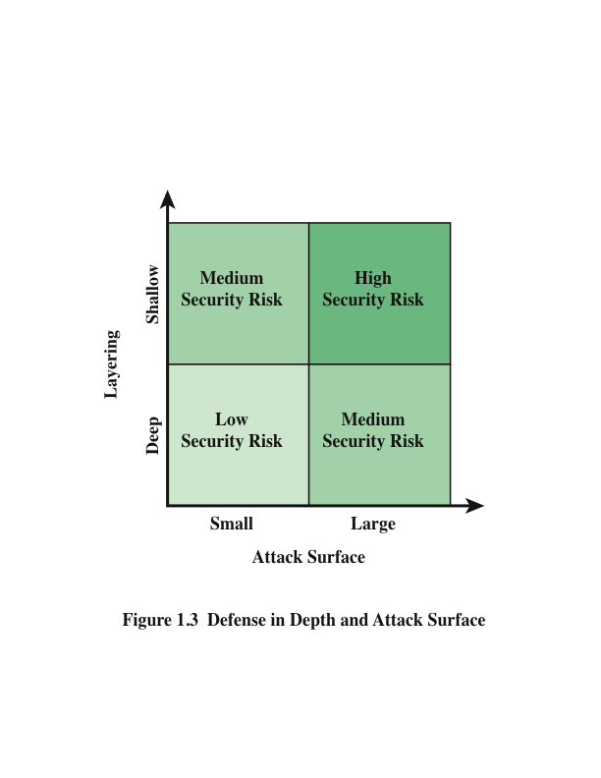
Notes:
As illustrated in Figure 1.3, the use of layering, or defense in depth, and attack
surface reduction complement each other in mitigating security risk.

Slide 47

Attack trees
A branching, hierarchical data structure that represents a set of potential techniques for exploiting security vulnerabilities
The security incident that is the goal of the attack is represented as the root node of the tree
The ways that an attacker could reach that goal are iteratively and incrementally represented as branches and subnodes of the tree
The final nodes on the paths outward from the root, the leaf nodes, represent different ways to initiate an attack
Branches can be labeled with values representing difficulty, cost, or other attack attributes, so that alternative attacks can be compared
Notes:
An attack tree is a branching, hierarchical data structure that represents a set of
potential techniques for exploiting security vulnerabilities [MAUW05, MOOR01,
SCHN99]. The security incident that is the goal of the attack is represented as the
root node of the tree, and the ways that an attacker could reach that goal are iteratively
and incrementally represented as branches and subnodes of the tree. Each
subnode defines a subgoal, and each subgoal may have its own set of further subgoals,
etc. The final nodes on the paths outward from the root, that is, the leaf nodes,
represent different ways to initiate an attack. Each node other than a leaf is either
an AND-node or an OR-node. To achieve the goal represented by an AND-node,
the subgoals represented by all of that node’s subnodes must be achieved; and for
an OR-node, at least one of the subgoals must be achieved. Branches can be labeled
with values representing difficulty, cost, or other attack attributes, so that alternative
attacks can be compared.
The motivation for the use of attack trees is to effectively exploit the information
available on attack patterns. Organizations such as CERT publish security
advisories that have enabled the development of a body of knowledge about both
general attack strategies and specific attack patterns. Security analysts can use the
attack tree to document security attacks in a structured form that reveals key vulnerabilities.
The attack tree can guide both the design of systems and applications,
and the choice and strength of countermeasures.

Slide 48
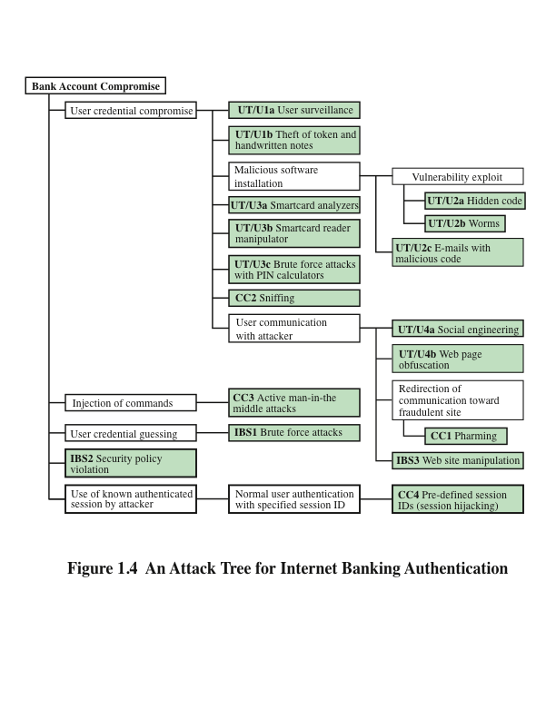
Notes:
Figure 1.4, based on a figure in [DIMI07], is an example of an attack tree
analysis for an Internet banking authentication application. The root of the tree is the objective of the attacker, which is to compromise a user’s account. The shaded
boxes on the tree are the leaf nodes, which represent events the comprise the
attacks. Note that in this tree in this example, all the nodes other than leaf nodes
are OR-nodes. The analysis to generate this tree considered the three components
involved in authentication:
■ User terminal and user (UT/U): These attacks target the user equipment,
Including the tokens that may be involved, such as smartcards or other password
generators, as well as the actions of the user.
■ Communications channel (CC): This type of attack focuses on communication
links.
■ Internet banking server (IBS): These types of attacks are offline attacks against
the servers that host the Internet banking application.
Five overall attack strategies can be identified, each of which exploits one or
more of the three components. The five strategies are as follows:
■ User credential compromise: This strategy can be used against many elements
of the attack surface. There are procedural attacks, such as monitoring a user’s
action to observe a PIN or other credential, or theft of the user’s token or
handwritten notes. An adversary may also compromise token information
using a variety of token attack tools, such as hacking the smartcard or using a
brute force approach to guess the PIN. Another possible strategy is to embed
malicious software to compromise the user’s login and password. An adversary
may also attempt to obtain credential information via the communication
channel (sniffing). Finally, an adversary may use various means to engage in
communication with the target user, as shown in Figure 1.4.
■ Injection of commands: In this type of attack, the attacker is able to intercept
communication between the UT and the IBS. Various schemes can be used to
be able to impersonate the valid user and so gain access to the banking system.
■ User credential guessing: It is reported in [HILT06] that brute force attacks
against some banking authentication schemes are feasible by sending random
usernames and passwords. The attack mechanism is based on distributed
zombie personal computers, hosting automated programs for username- or
password-based calculation.
■ Security policy violation: For example, violating the bank’s security policy in
combination with weak access control and logging mechanisms, an employee
may cause an internal security incident and expose a customer’s account.
■ Use of known authenticated session: This type of attack persuades or forces
the user to connect to the IBS with a preset session ID. Once the user authenticates
to the server, the attacker may utilize the known session ID to send
packets to the IBS, spoofing the user’s identity.
Figure 1.4 provides a thorough view of the different types of attacks on an
Internet banking authentication application. Using this tree as a starting point, security
analysts can assess the risk of each attack and, using the design principles outlined
in the preceding section, design a comprehensive security facility. [DIMI07]
provides a good account of the results of this design effort.

Slide 49
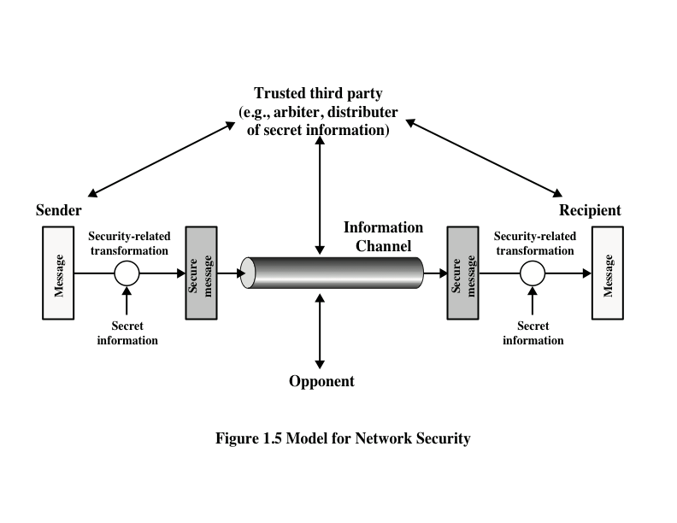
Model for Network Security

Slide 50
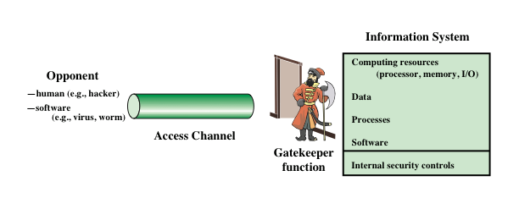
Network Access Security Model

Slide 51
Model for Network Security
This model requires us to :
– design a suitable algorithm for the security-related transformation
– generate the secret information (keys) used by the algorithm
– develop methods to distribute and share the secret information
– specify a protocol enabling the principals to use the transformation and secret information for a security service

Slide 52
Unwanted Access
Programs can present two kinds of threats:
Information access threats
Intercept or modify data on behalf of users who should not have access to that data
Service threats
Exploit service flaws in computers to inhibit use by legitimate users
Placement in a computer system of logic that exploits vulnerabilities in the system and that can affect application programs as well as utility programs
Notes:
Another type of unwanted access is the placement in a computer system
of logic that exploits vulnerabilities in the system and that can affect application
programs as well as utility programs, such as editors and compilers. Programs can
present two kinds of threats:
1. Information access threats: Intercept or modify data on behalf of users who
should not have access to that data.
2. Service threats: Exploit service flaws in computers to inhibit use by legitimate
users.
Viruses and worms are two examples of software attacks. Such attacks can be
introduced into a system by means of a disk that contains the unwanted logic concealed
in otherwise useful software. They also can be inserted into a system across a
network; this latter mechanism is of more concern in network security.
The security mechanisms needed to cope with unwanted access fall into two
broad categories (see Figure 1.6). The first category might be termed a gatekeeper
function. It includes password-based login procedures that are designed to deny
access to all but authorized users and screening logic that is designed to detect
and reject worms, viruses, and other similar attacks. Once either an unwanted user
or unwanted software gains access, the second line of defense consists of a variety
of internal controls that monitor activity and analyze stored information in an
attempt to detect the presence of unwanted intruders. These issues are explored in
Part Three.

Slide 53
Standards
NIST
ISOC
National Institute of Standards and Technology
U.S. federal agency that deals with measurement science, standards, and technology related to U.S. government use and to the promotion of U.S. private-sector innovation
NIST Federal Information Processing Standards (FIPS) and Special Publications (SP) have a worldwide impact
Internet Society
Professional membership society with worldwide organizational and individual membership
Provides leadership in addressing issues that confront the future of the Internet
Is the organization home for the groups responsible for Internet infrastructure standards, including the Internet Engineering Task Force (IETF) and the Internet Architecture Board (IAB)
Internet standards and related specifications are published as Requests for Comments (RFCs)
Notes:
Many of the security techniques and applications described in this book have been
specified as standards. Additionally, standards have been developed to cover
management practices and the overall architecture of security mechanisms and
services. Throughout this book, we describe the most important standards in use
or being developed for various aspects of cryptography and network security.
Various organizations have been involved in the development or promotion of
these standards. The most important (in the current context) of these organizations
are as follows.
• National Institute of Standards and Technology: NIST is a U.S. federal agency
that deals with measurement science, standards, and technology related to
U.S. government use and to the promotion of U.S. private-sector innovation.
Despite its national scope, NIST Federal Information Processing Standards
(FIPS) and Special Publications (SP) have a worldwide impact.
• Internet Society: ISOC is a professional membership society with worldwide
organizational and individual membership. It provides leadership in addressing
issues that confront the future of the Internet and is the organization
home for the groups responsible for Internet infrastructure standards,
including the Internet Engineering Task Force (IETF) and the Internet
Architecture Board (IAB). These organizations develop Internet standards
and related specifications, all of which are published as Requests for
Comments (RFCs) .
A more detailed discussion of these organizations is contained in Appendix C.

Slide 54
Summary
Computer security concepts
Definition
Examples
Challenges
The OSI security architecture
Security attacks
Passive attacks
Active attacks
Model for network security
Standards
Security services
Authentication
Access control
Data confidentiality
Data integrity
Nonrepudiation
Availability service
Security mechanisms
Attack surfaces and attack trees
Attack surfaces
Attack trees
Notes:
Chapter 1 summary.

Slide 55
Further reading
Chapter 1 of the textbook: Network Security Essentials- Application & Standards” by William Stallings 6th Edition, 2017

Slide 56

http://www.cybersafe.my/cyberyouths-posters.html

